Slide 1
Lab 7
Grace Dreiling

Slide 2
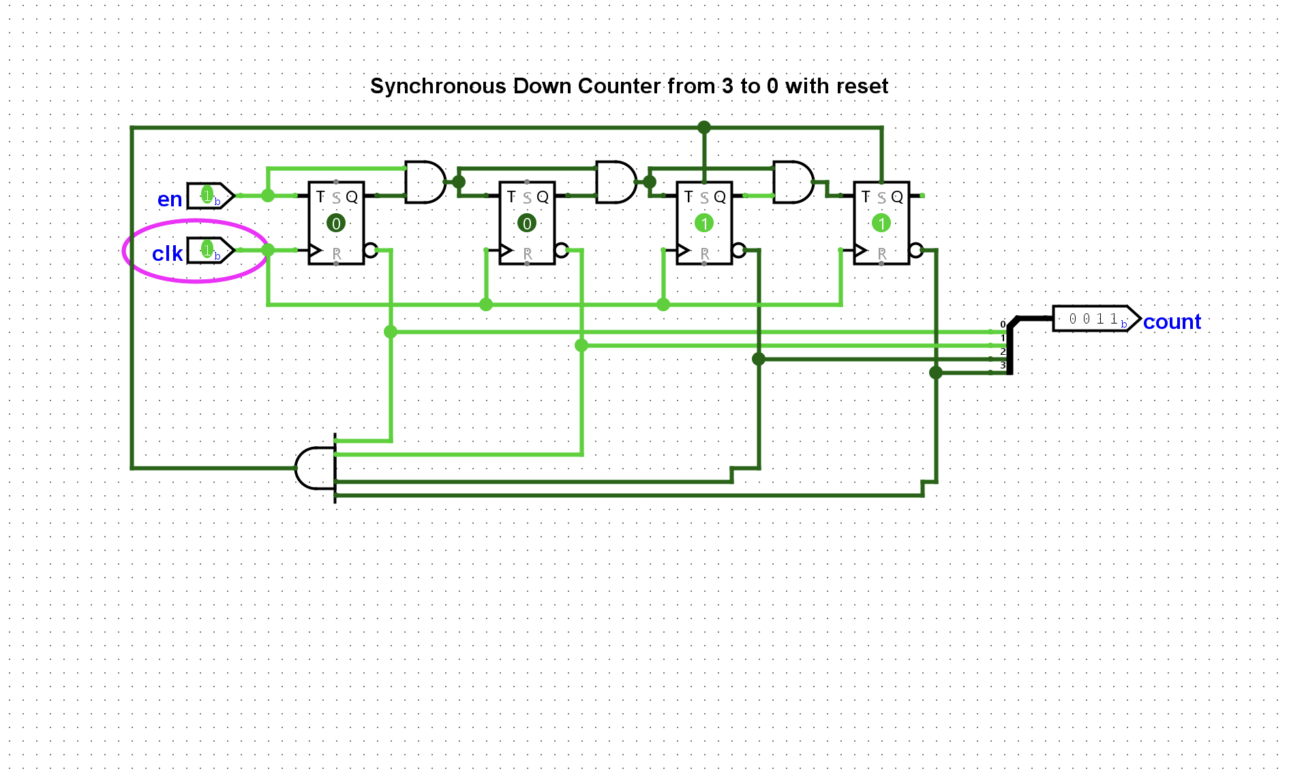
Down-counter from 3-0
Set the counter set pins to the complement of 3 in order to set the timer to go from 3-0

Slide 3
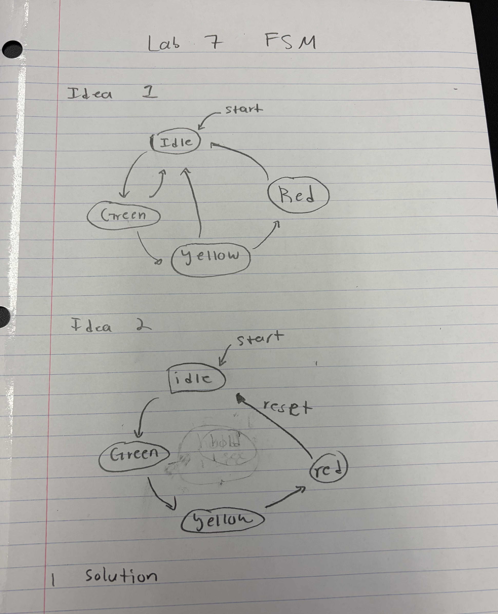
Drawing of FSM: Before Solution

Slide 4
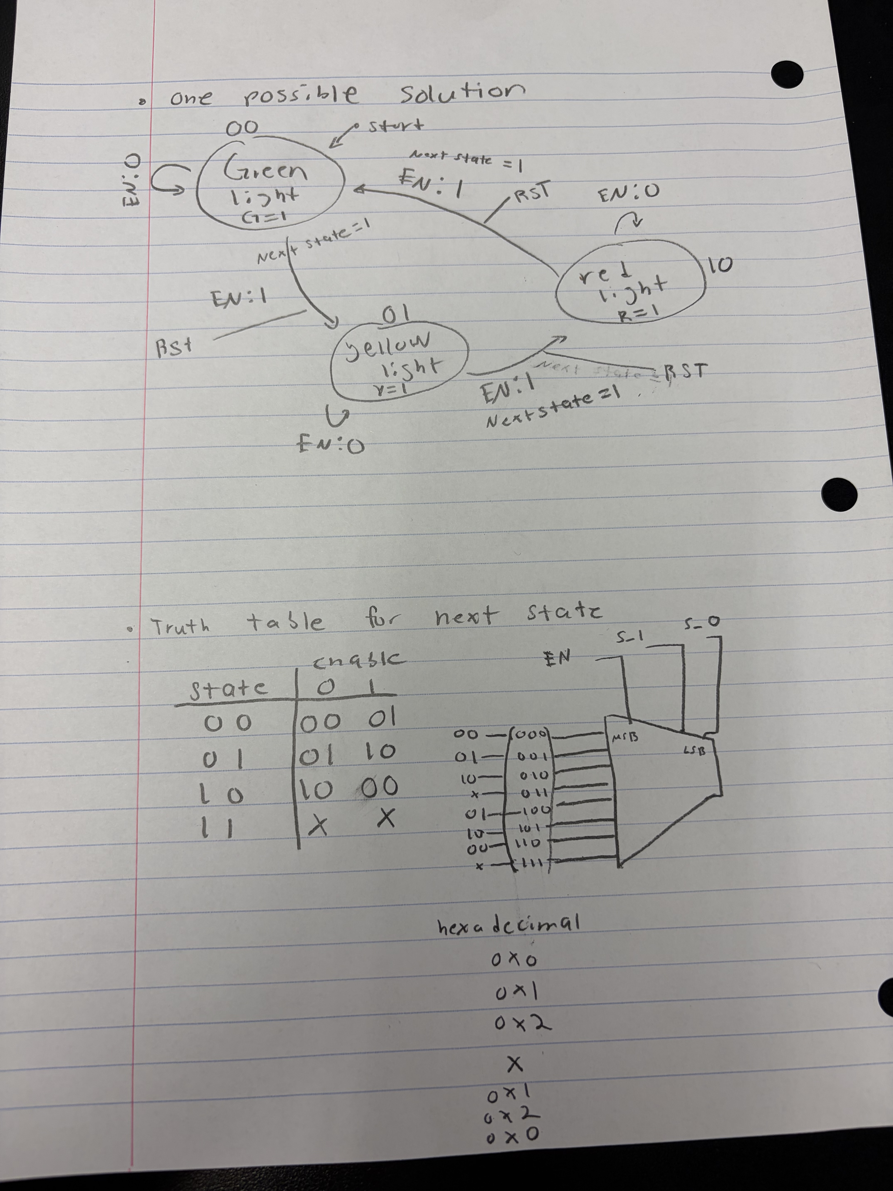
Drawing of FSM: After Solution + Truth Table for Next State

Slide 5
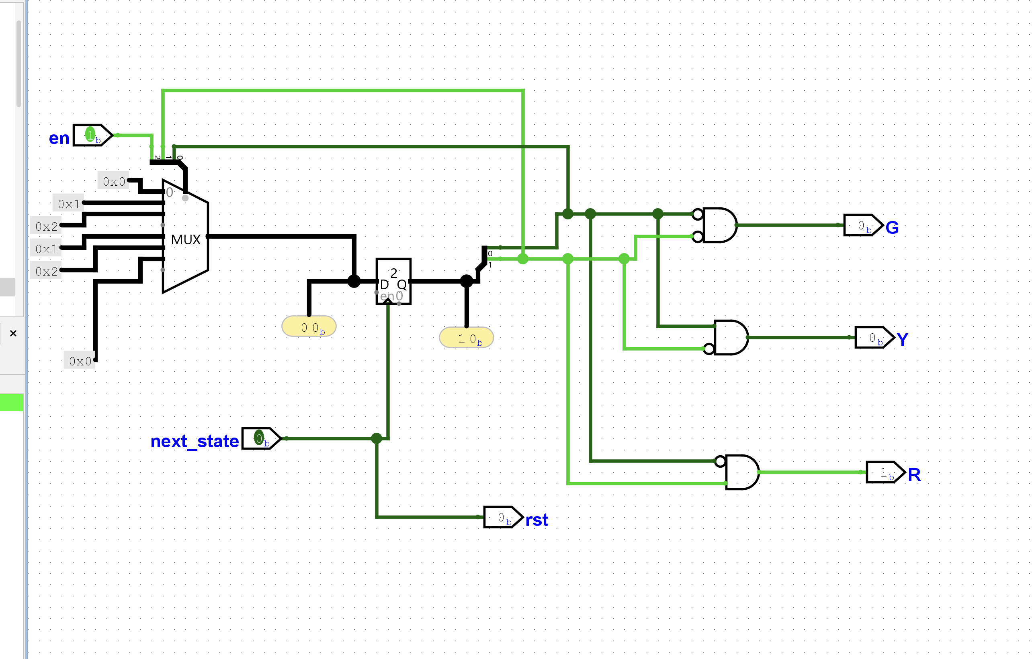
FSM Logic Circuit

Slide 6
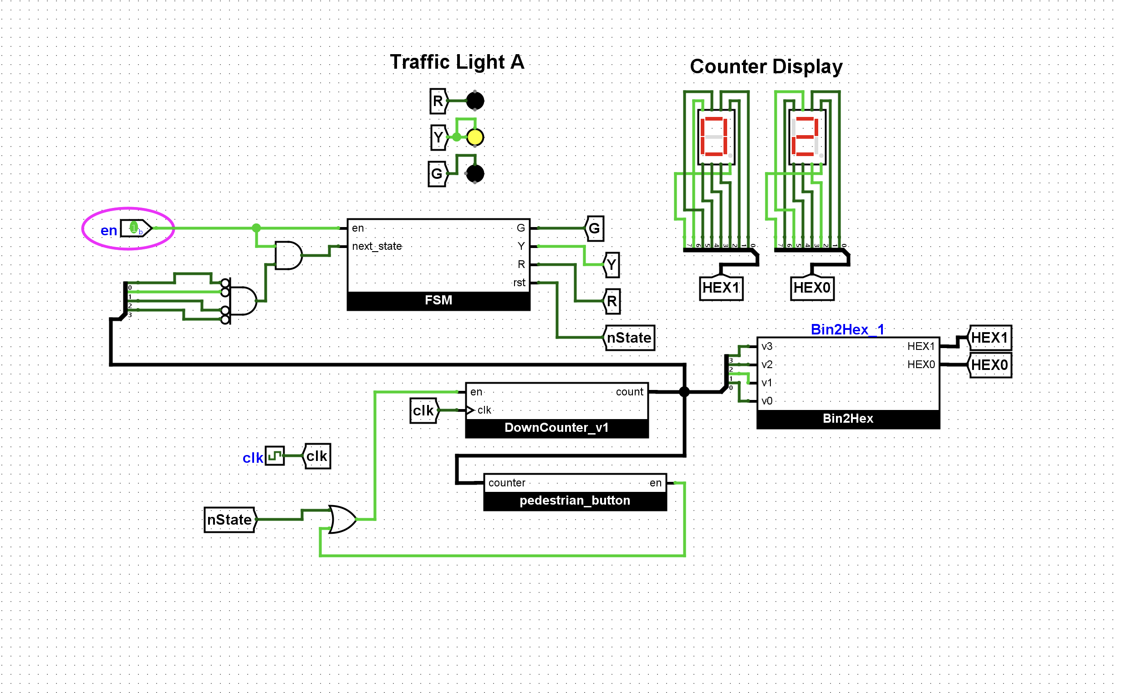
Final Circuit-Yellow

Slide 7
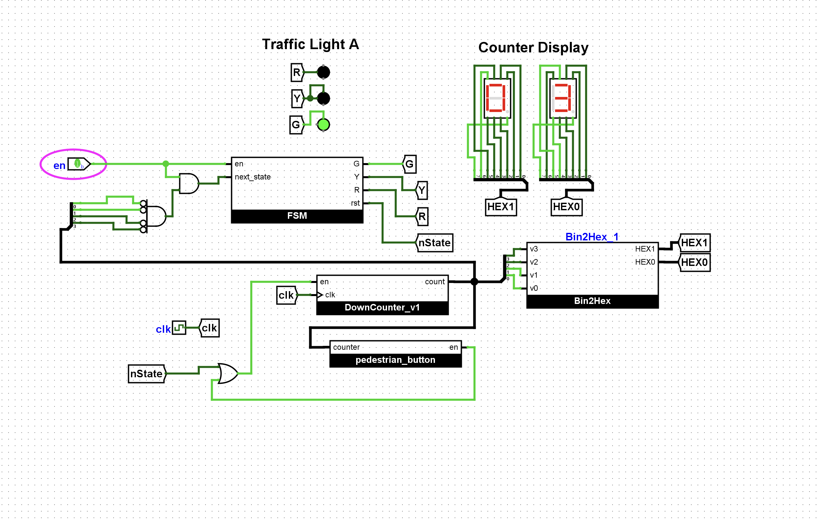
Final Circuit-Green

Slide 8
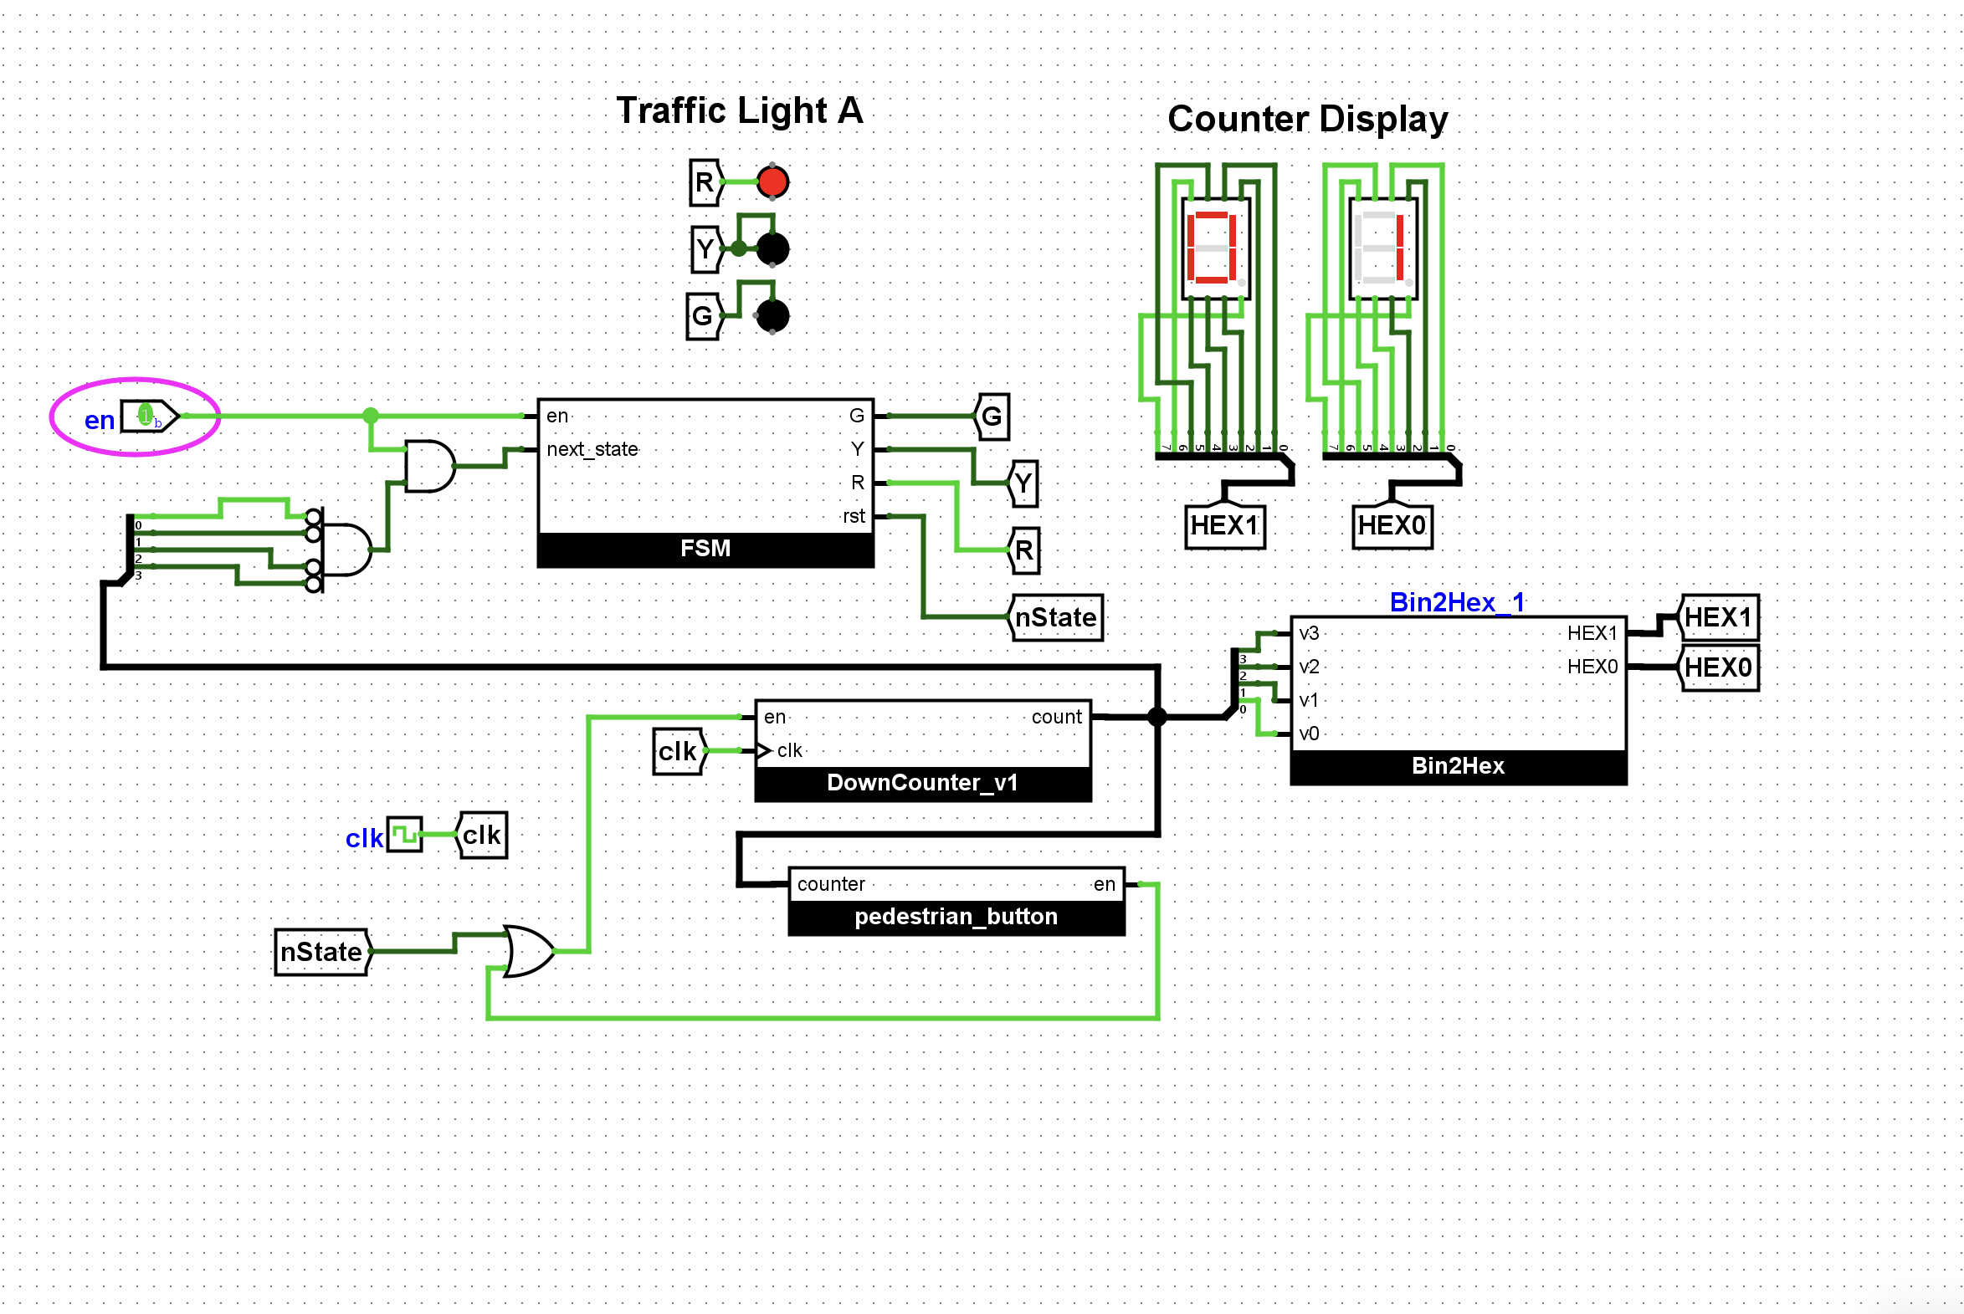
Final Circuit-Red

